Slide 1


EmoTalk: Sentiment Analysis on Audio Text Data
Ashwin Unnikrishnan
Sreelu Prasanna Nair
Pratyush Rokade

Slide 2

AGENDA
P​roblem Statement
Dataset
Algorithms
Methodology
​Results
Conclusion

Slide 3
Problem Statement
Sentiment analysis on audio data plays a crucial role in understanding human communication and extracting meaningful information from spoken language.
Applications of Audio sentiment analysis
Content Filtering and Safety
Social Media Monitoring
Psychological and Behavioral Analysis

Slide 4





Dataset
Twitter Sentiment Analysis
I love how people are complaining about Deadpool in Fortnite but never did for John Wick happening.
Borderlands 2 is so good omg
cutting out toxic relationships starting with Verizon who want me to "pay my overdue phone bill" . the audacity
Apple iPhone 7 Plus a1661 32GB Jet Black Verizon Very Good Condition (Unlocked)

Slide 5


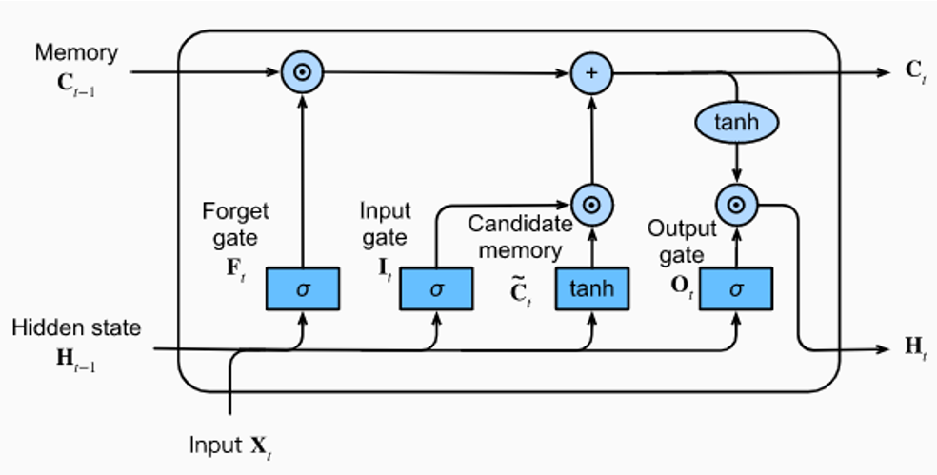

Algorithms
Random Forest
LSTM
BERT
Notes:
The three model algorithms we have used are LSTM, BERT and Random forest for ensemble learning.
Random forest is a type of ensemble learning technqiue that combines predictions of multiple indivdual decision trees to improve the overall
performance and generalization.
This algorithm is known to combine the predictions of multiple decision trees through a provess called majority voting.
The algorithm is especially useful to obtain a reduced overfitting, can capture non-linear relationships and handle diverse linguistic
characteristics in text data.
LSTM are a type of RNN architevture that is especially beneficial in NLP tasks that involve sequential data where context is important.
as shown in fig the cell state is an internal memory that stores info over time.
input gate determines how much new info needs to be added
forget gate decides what info from prev cell needs to be discarded
output gate - controls the amount of info that should be used to generate the output
hidden state - this is a transformed version of cell state and carries info to next time step.
BERT is a type of transformer-based arrchitecture that is well suited for large datasets and it excels at capturing contextual info
from text, this makes it highly effective for understanding and analysing sentiment in text data.
BERT is said to process text in both direcrions unlike traditional language models. It considers both the left and right contect of each
word in a sentence.

Slide 6
methodology
Random Forest
Train/Test split = 70/30
Experimenting manually (10 configuration)
Best configuration:
max_depth: 40, max_features: sqrt, n_estimators: 450
Grid Search with Cross Validation
Best configuration:
max_depth: 80, max_features: auto, n_estimators: 800
LSTM
Train/Test split = 0.33 for test
Model 1 and 3 has LSTM layer with 100 and 128 units while Model 2 has Bidirectional LSTM with 128 units.
Model 2 has a Batch Normalization and Dropout layer Model 3 has a Dropout layer
Two Dense layers in every model with Model 1 having 50 and 25 units, Model 2 having 64 and 32 units, and Model 3 having 128 and 64 units
BERT
Train/test split: 80/20
Two models – BERT and DistilBERT
4 different configurations for each model
Batch size=16, 32 and #epochs=2, 5
Learning Rate: 1e-5
Optimizer: Adam
Notes:
for random forest, we have manually configured 10 different combinations and out of the 10, we founf these params performing the bets.
but manually doung so would be tedious and time consuming, therefore in order to automate this process to find the optimal param we used
an algo like gridsearch with 5 fold cross validation, and we obtained these as the best params.
we have used 3 different models for LSTM as shown here, and models 1 and 3 use 100 and 128 LSTM units, this helps gain a balance between
capturing relevant patterns and avoiding model complexity. model 2 uses a bidirectional LSTM which processes seq in both directions.
models with high capacity that is more lstm units and dense units have the potential to capture intricate aptterns in data, and therefore
we have chosen these values.
the train test split for using bert model is 80:20, with 2 models bert and distilbert. distilbert is a smaller version of the bert designed
to be more memory efficient. the chosen configurations worked well as they take into account the memory contraints, model convergence and
trade-off between computational resources and performance.
we have used batch sizes of 16 and 32, while a learning rate as shown, and the adam optimizer adapts the learning rarte for faster convergence
and better optimization.

Slide 7
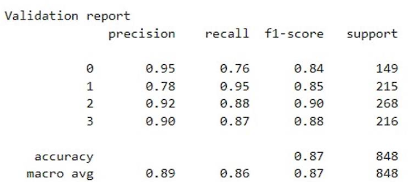
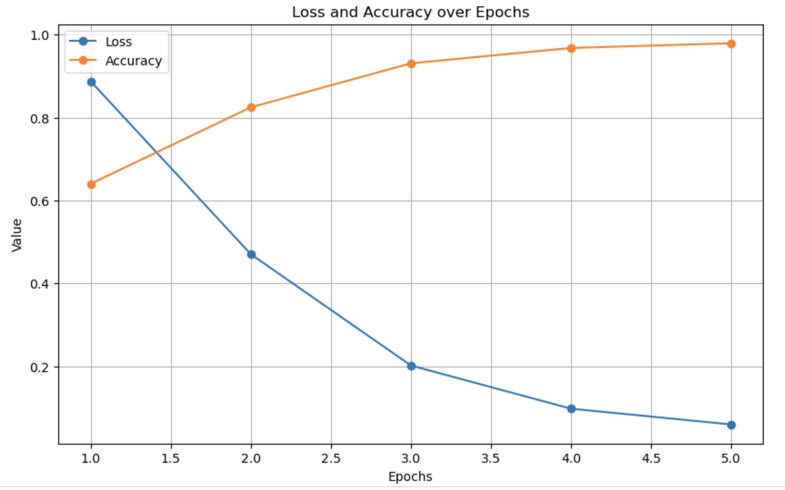
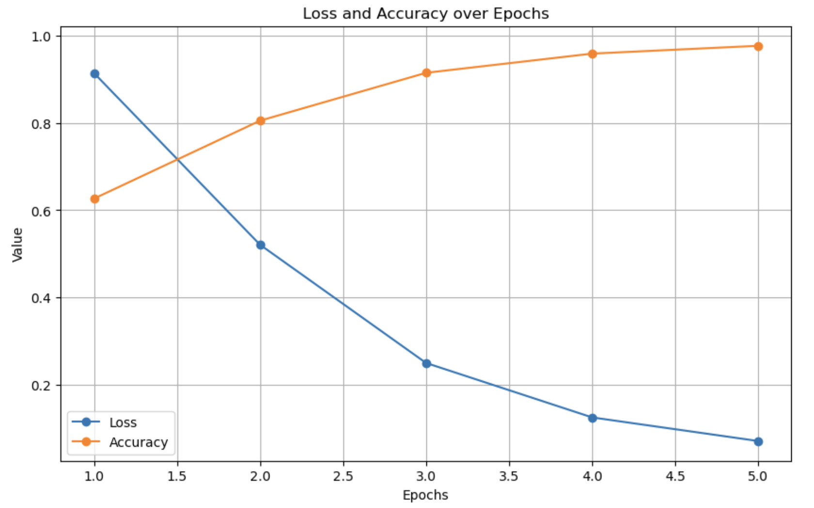
results
Random Forest
BERT and DistilBERT
LSTM
Model Number | Train Accuracy | Test Accuracy
Model 1 | 0.9641 | 0.8468
Model 2 | 0.9597 | 0.8482
Model 3 | 0.9405 | 0.8349

Slide 8
conclusion
Runtime follows an increasing order between Random Forest, LSTM and BERT
Increasing batch size decreases execution time but decreasing batch size leads to overfitting
BERT outperforms the other two algorithms as it amounts to an accuracy of 93%

Slide 9
THANK YOU

